Slide 1
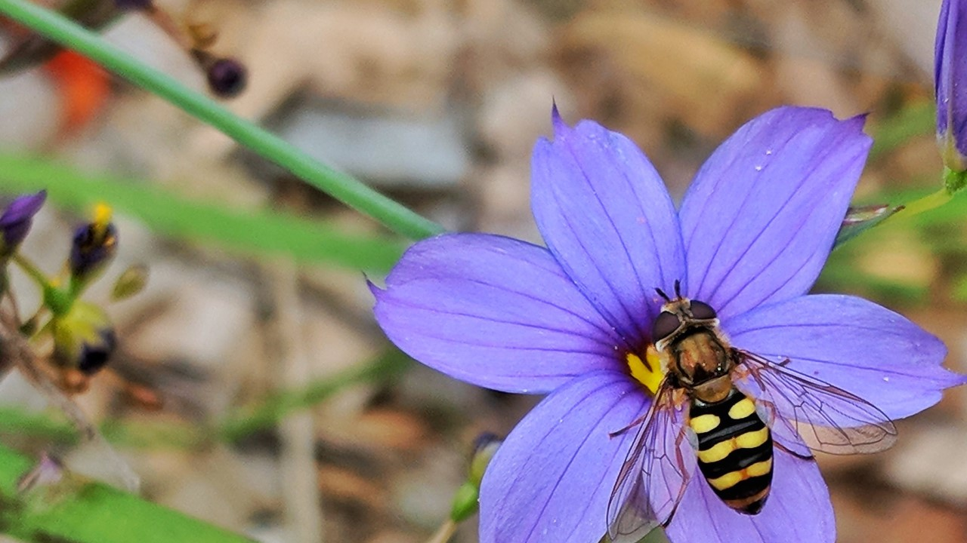
Naturing at Home

Slide 2
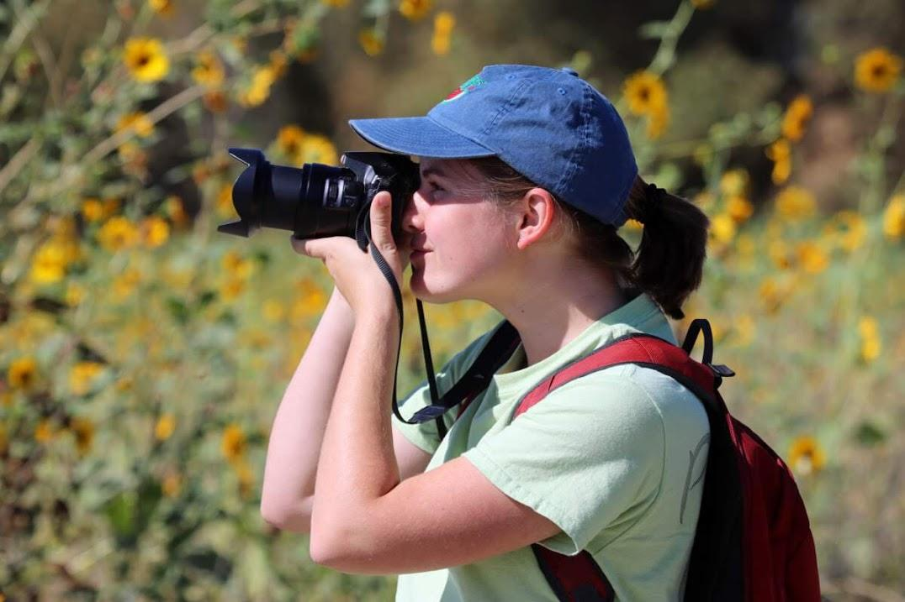
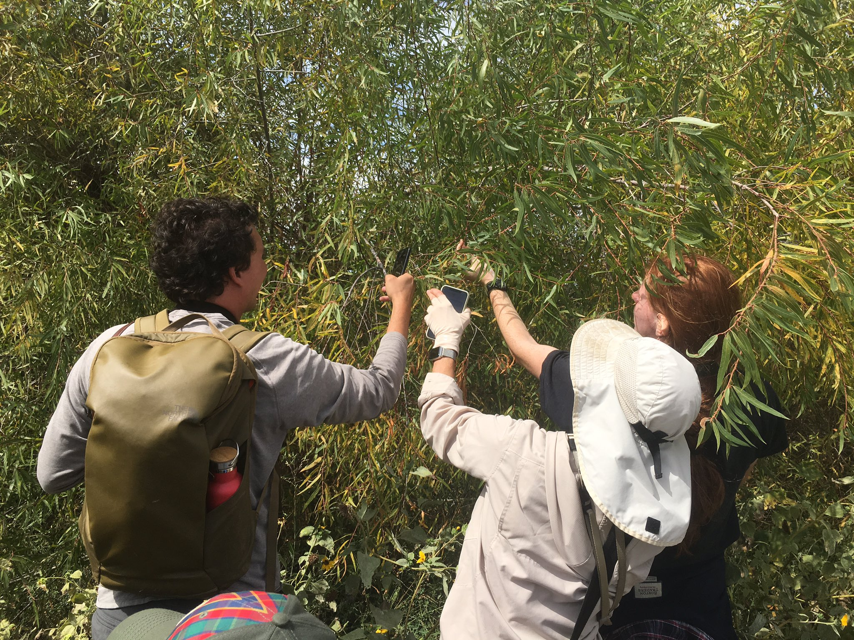
Why?
Anyone can do it anywhere! All you need is a camera (point and shoot or phone)!
We can create a huge observation set about our local habitats
We get to collaborate and help each other with identifications
We get to know the whos and what is in our gardens, parks, or neighborhoods.
We can see how biodiversity varies across the Wildland to Urban scale
wildland, rural, suburban, residential, urban

Slide 3
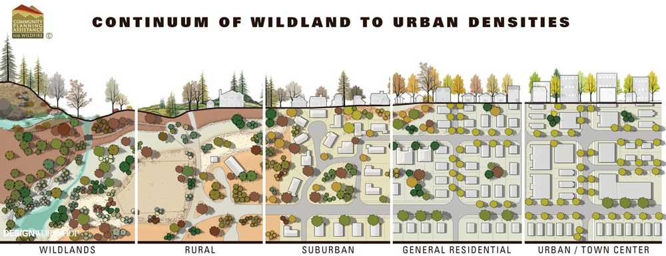
Courtesy of City Nature Challenge and Community Planning Assistance for Wildfire

Slide 4
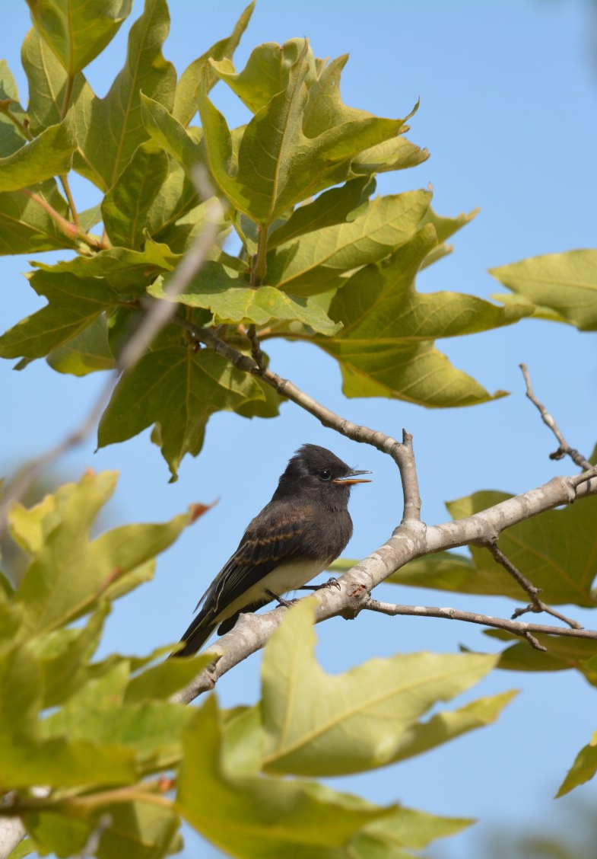
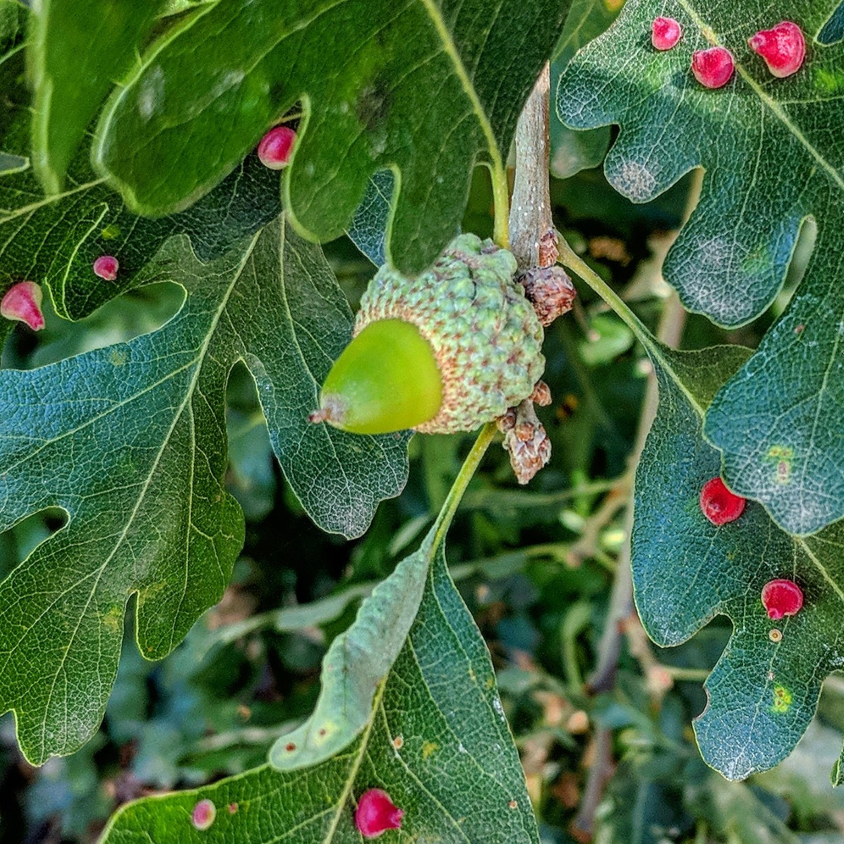
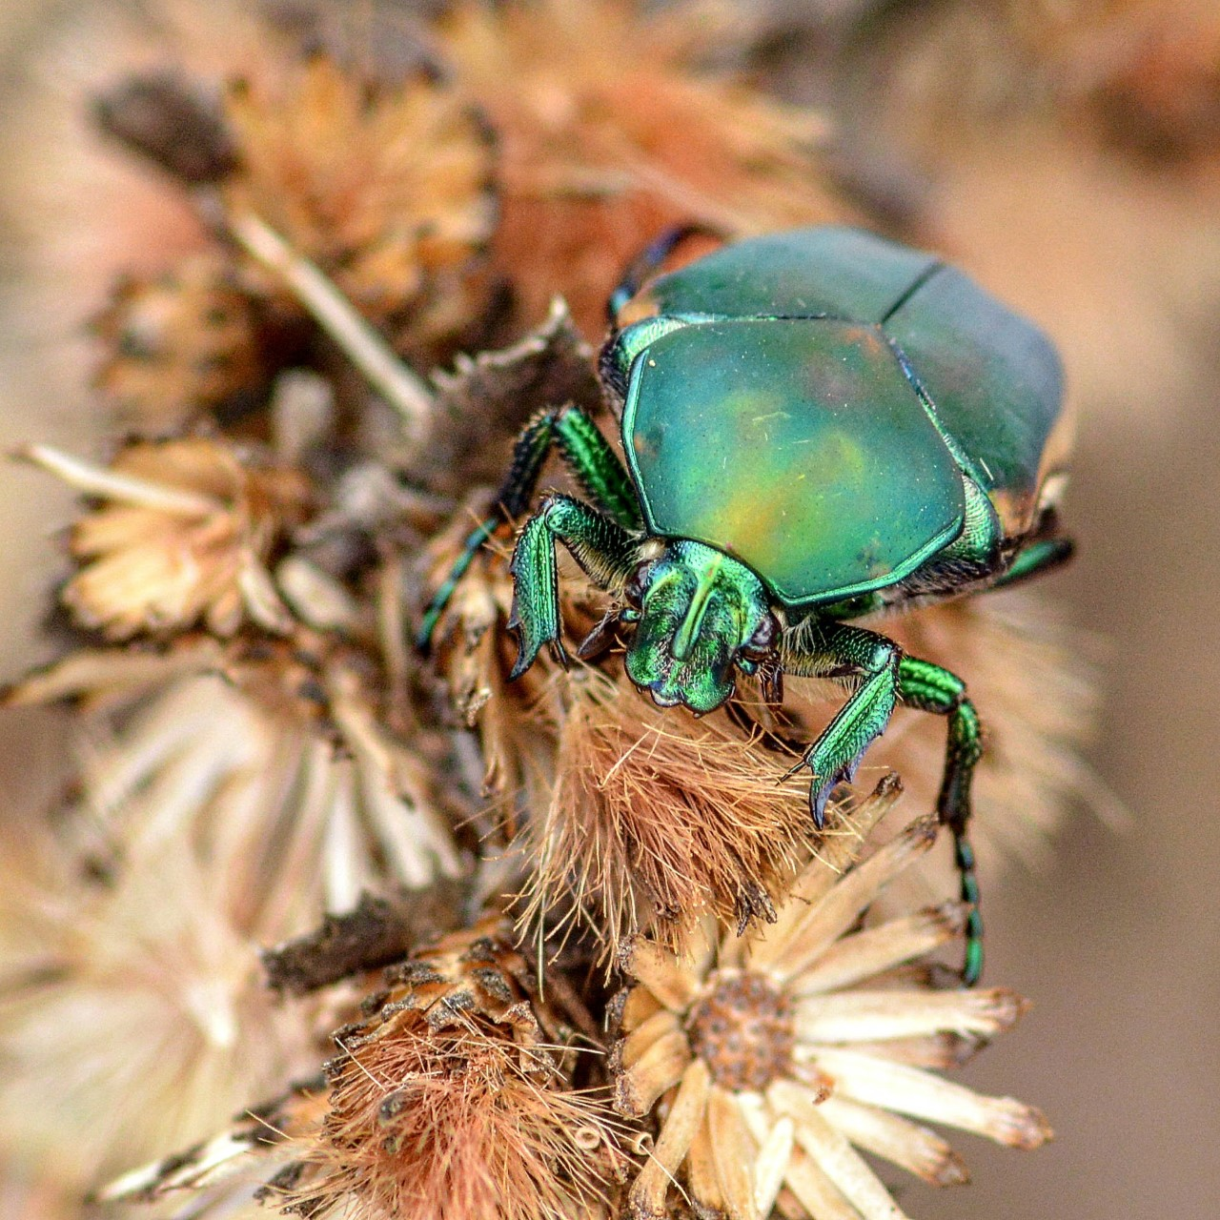
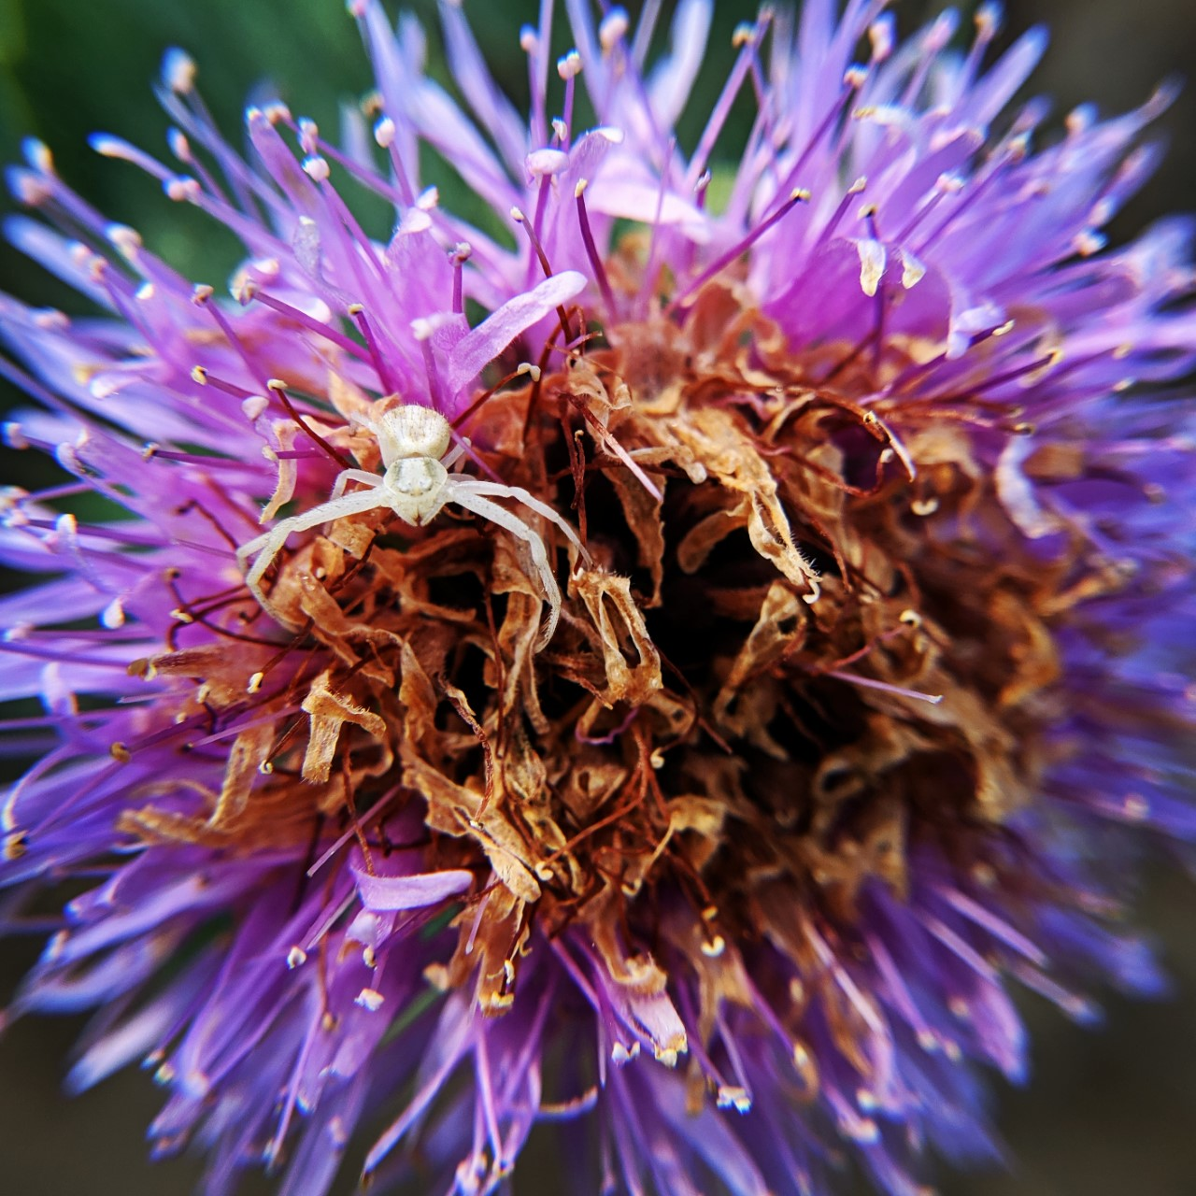
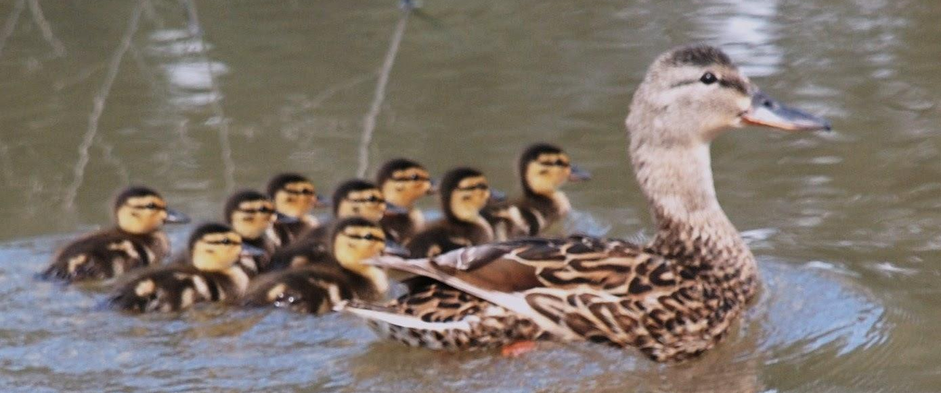
Getting started
Download the app or head over to iNaturalist website
Create an account using your UC Davis email
Projects collect the observations and help build biodiversity data
Right now we are starting the “Naturing at Home” project and if you join, your observations will be automatically added.

Slide 5
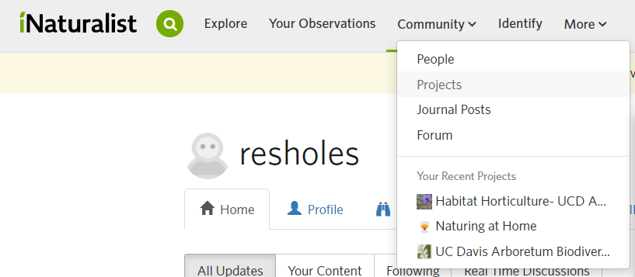
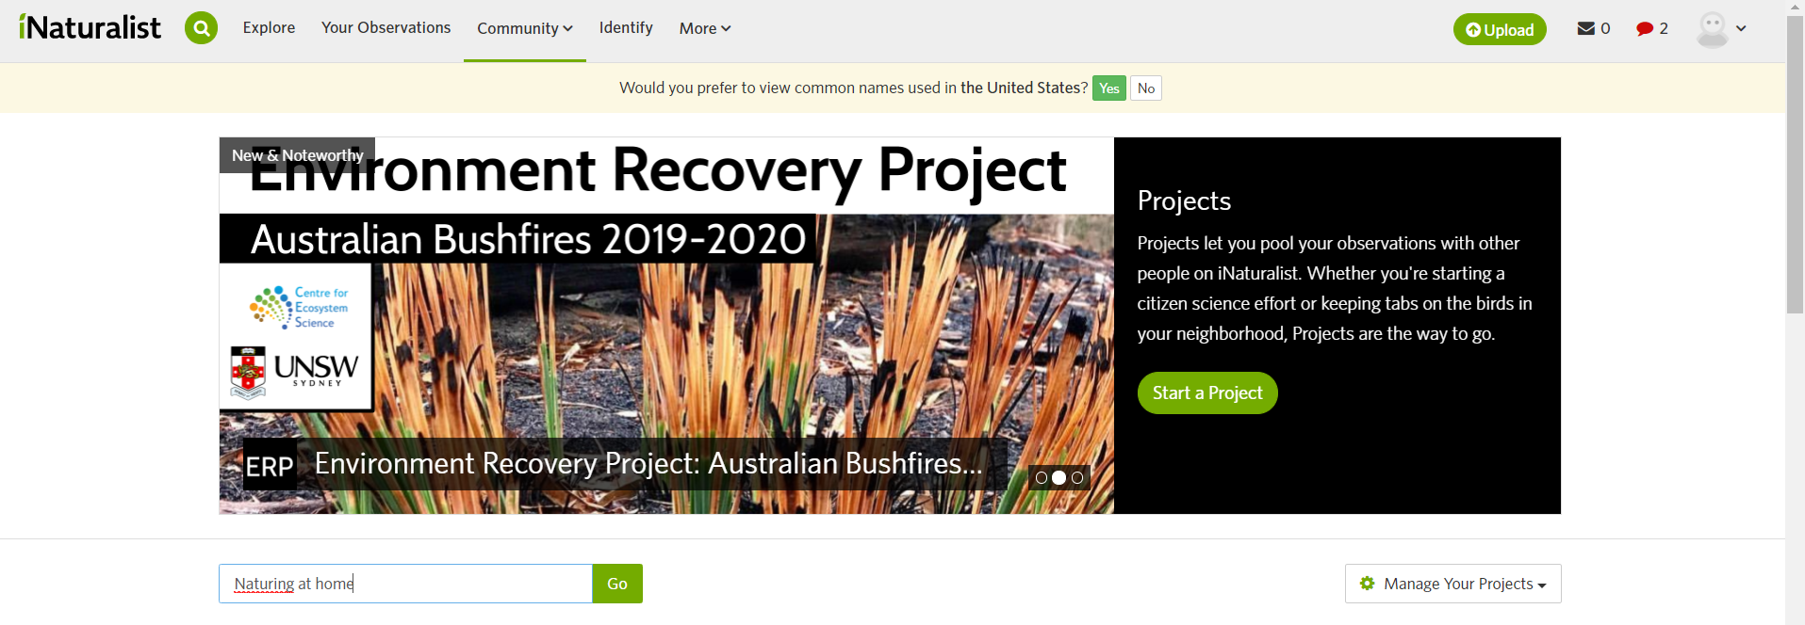
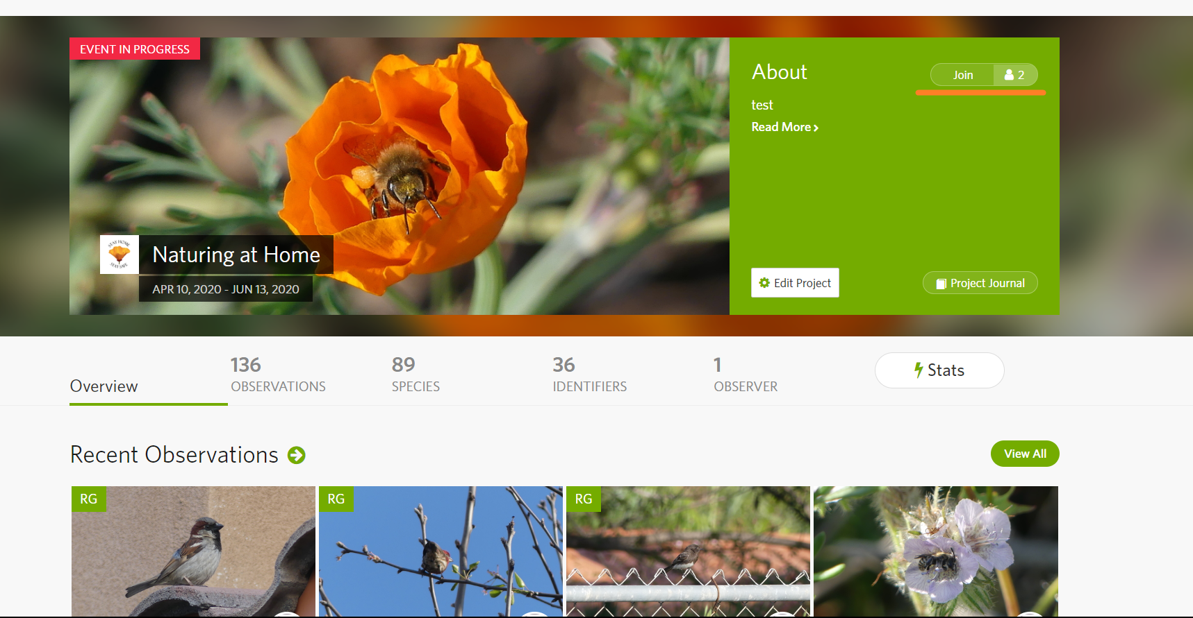
On iNaturalist.org
Join the project
Sign Up

Slide 6
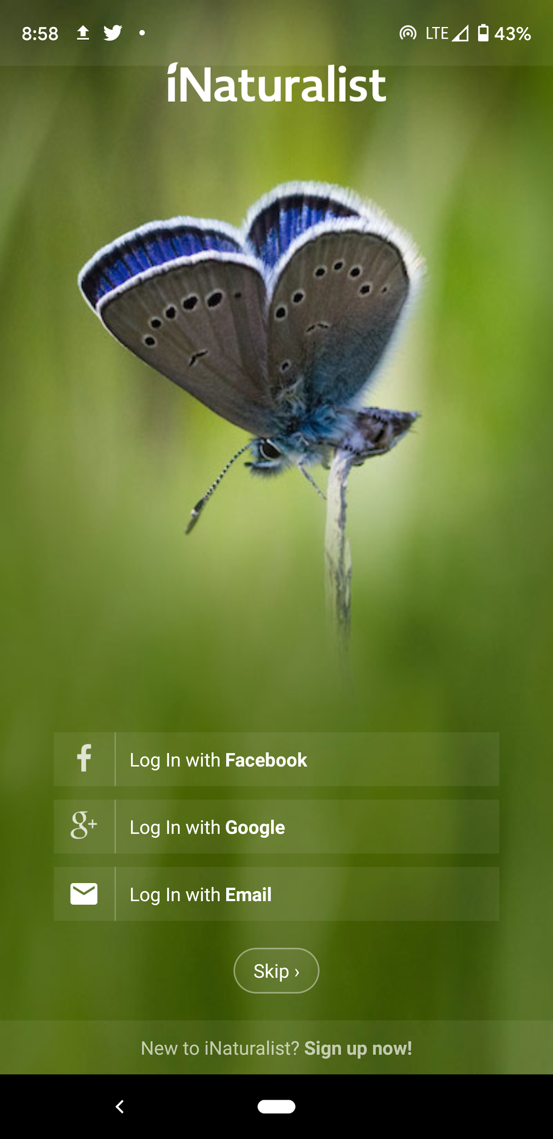
On the App
Join the project
Sign Up

Slide 7
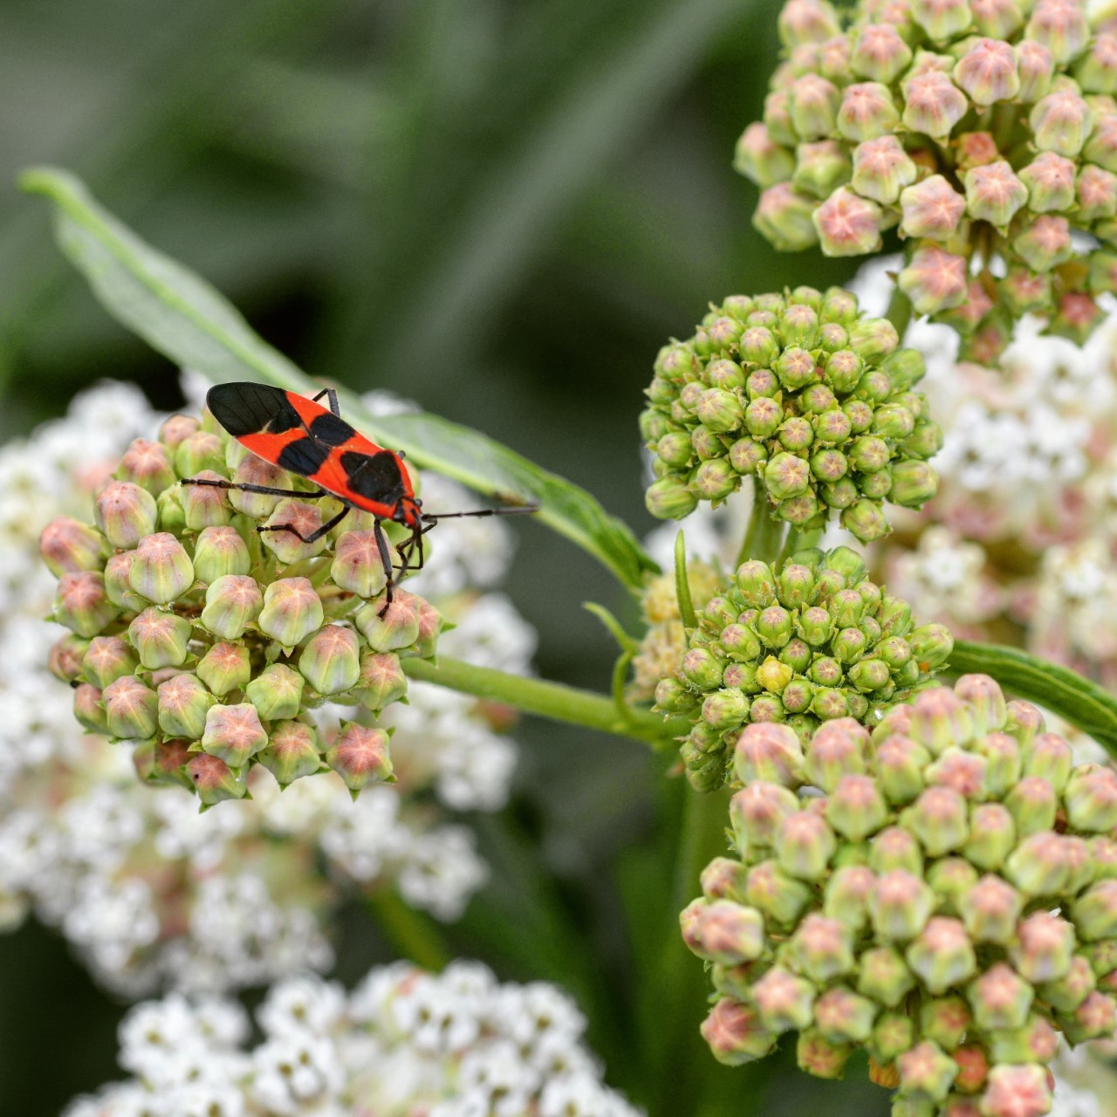
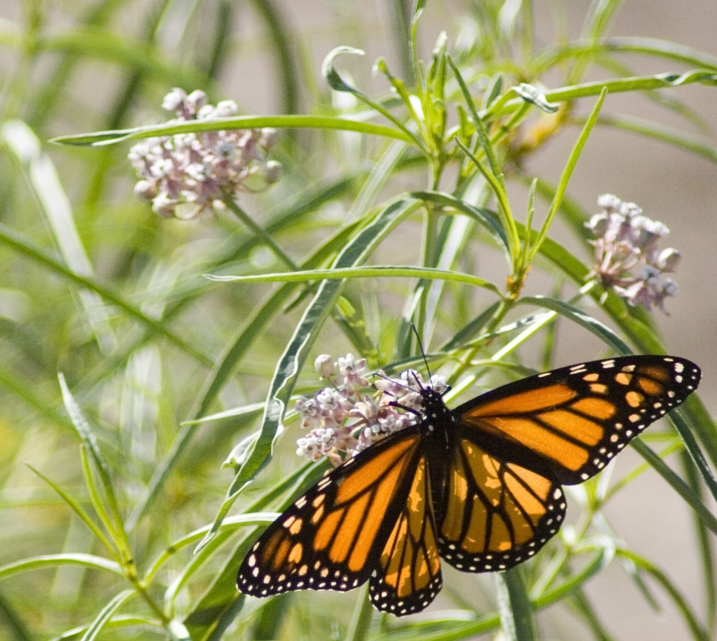
Uploading an observation
Wander around your backyard or neighborhood and see what you can see
Sit in one place and see what visits a specific area is a great way to capture multiple species
When you do capture some critter, you should also add the plant that its interacting with. You can do this with the same photo or take a new one
Add your photo, time, date, location, and mark if its captive or cultivated (put there by people )
If you join “Naturing at Home” be sure to add your terrain type to your observations
On the website, add an “Observation Field” and type “Wild to Urban” and chose your terrain type
On the APP, put the terrain type in the description (Wild, rural, suburban, residential, urban)
You can then go on to the desktop to add the field properly by editing your observation
Then submit your observation!

Slide 8
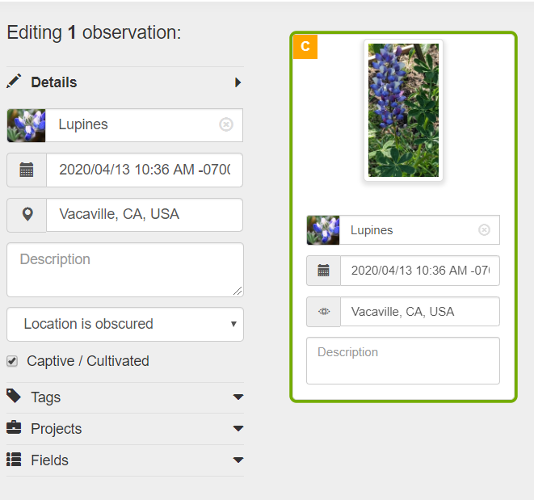
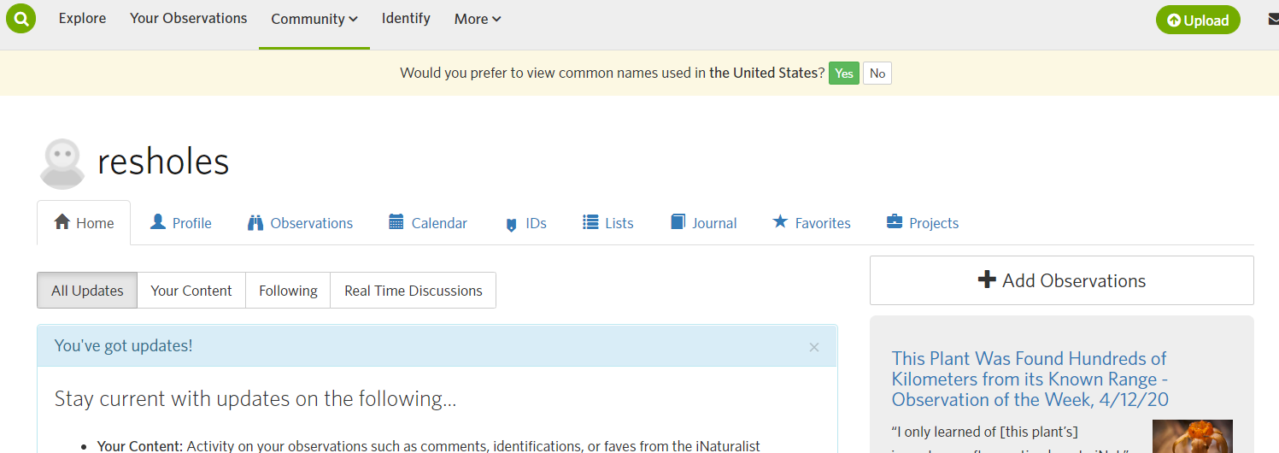
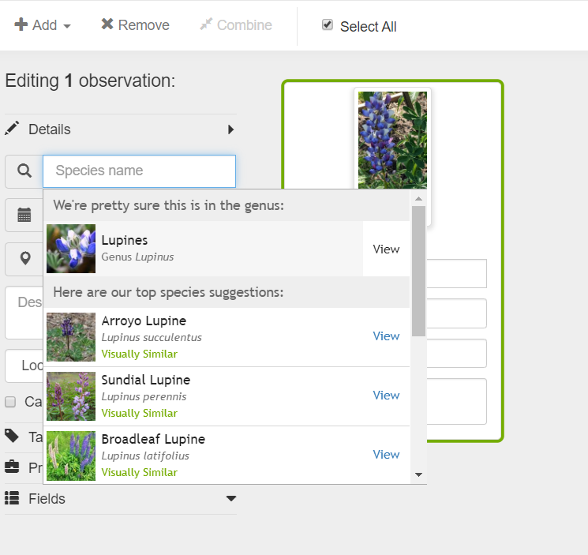
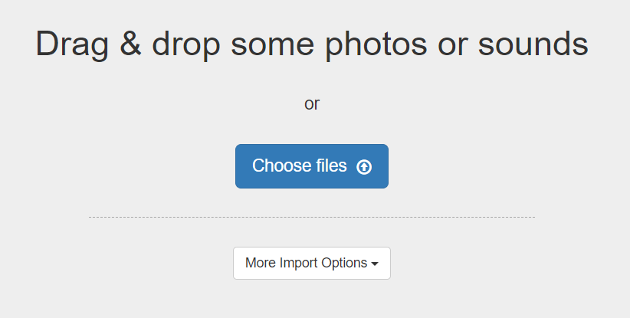
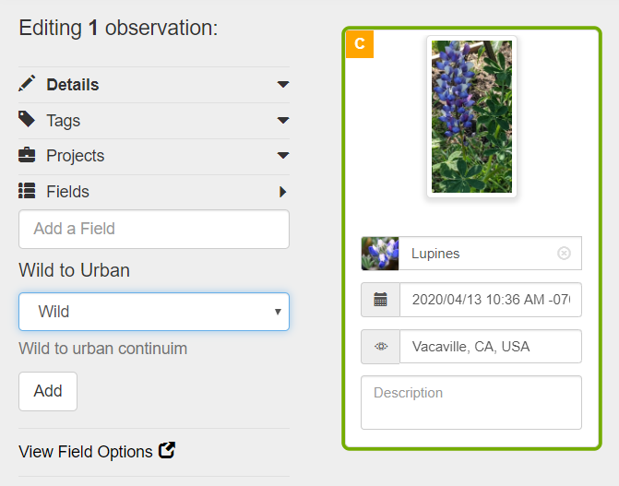
On iNaturalist.org
Add time, species and location
iNaturalist will make a suggestion
Search for the “Wild to Urban” field and select your terrain
Be sure to click add!

Slide 9
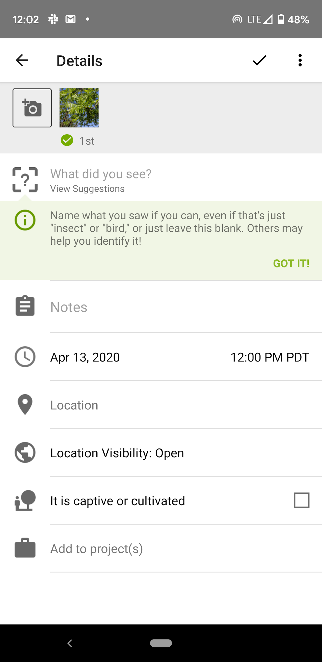
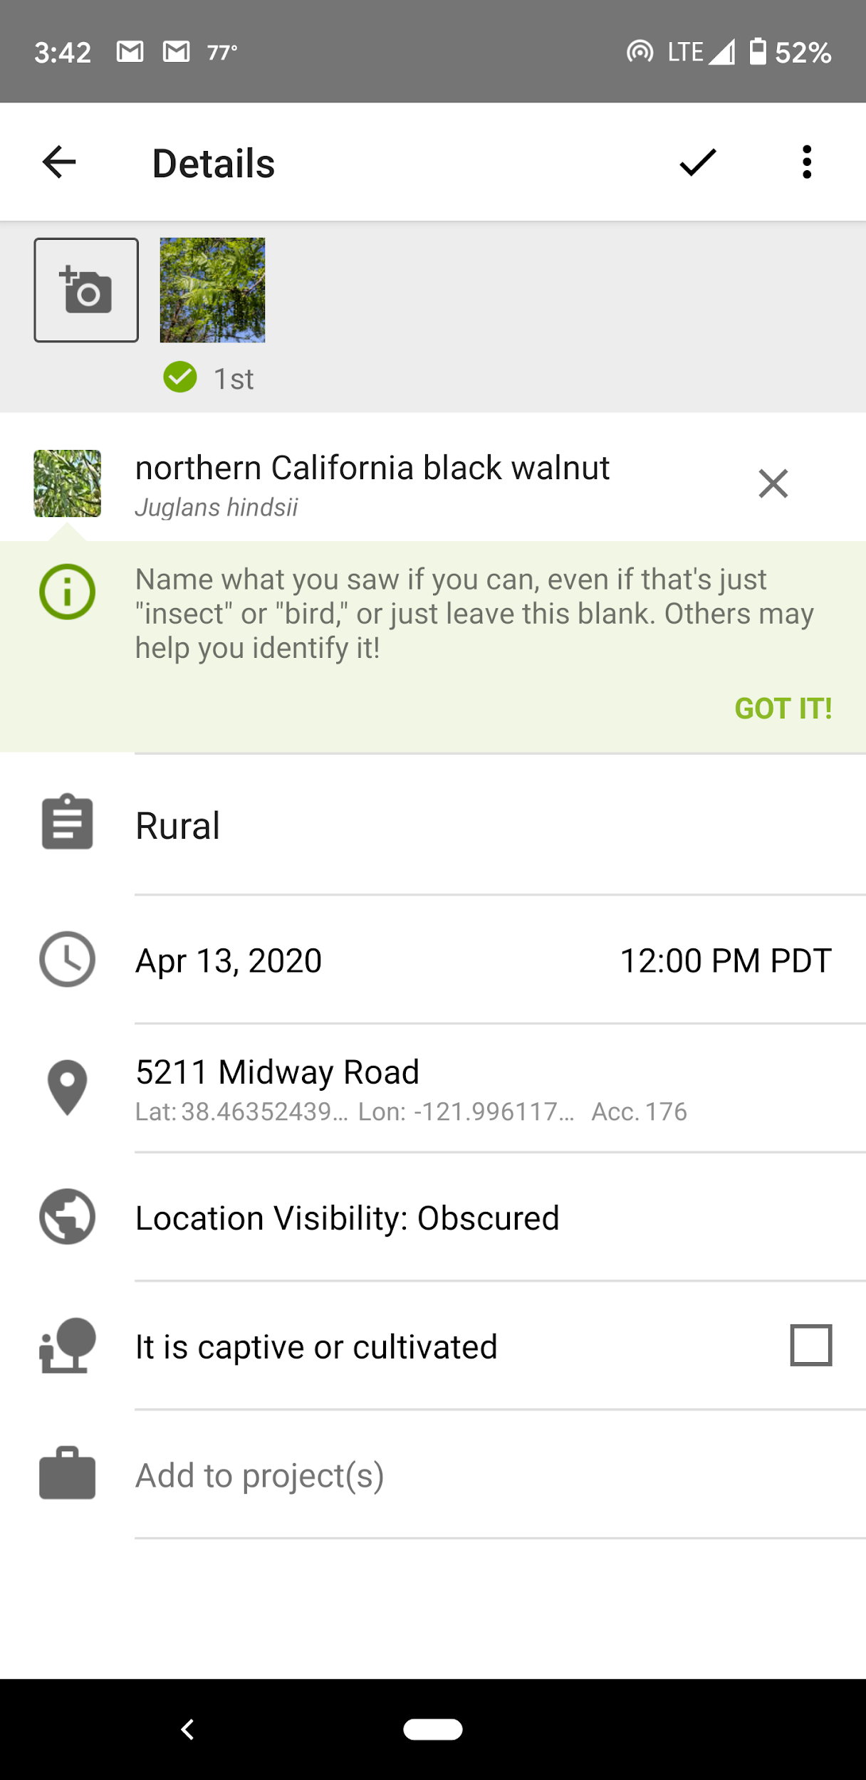
On the App
Click on the plus on the home screen
Fill out all of the fields.
Don’t forget to put your terrain type in the notes
(Wild, rural, urban, suburban, urban
Click the check and your observation will be auto added to the project

Slide 10
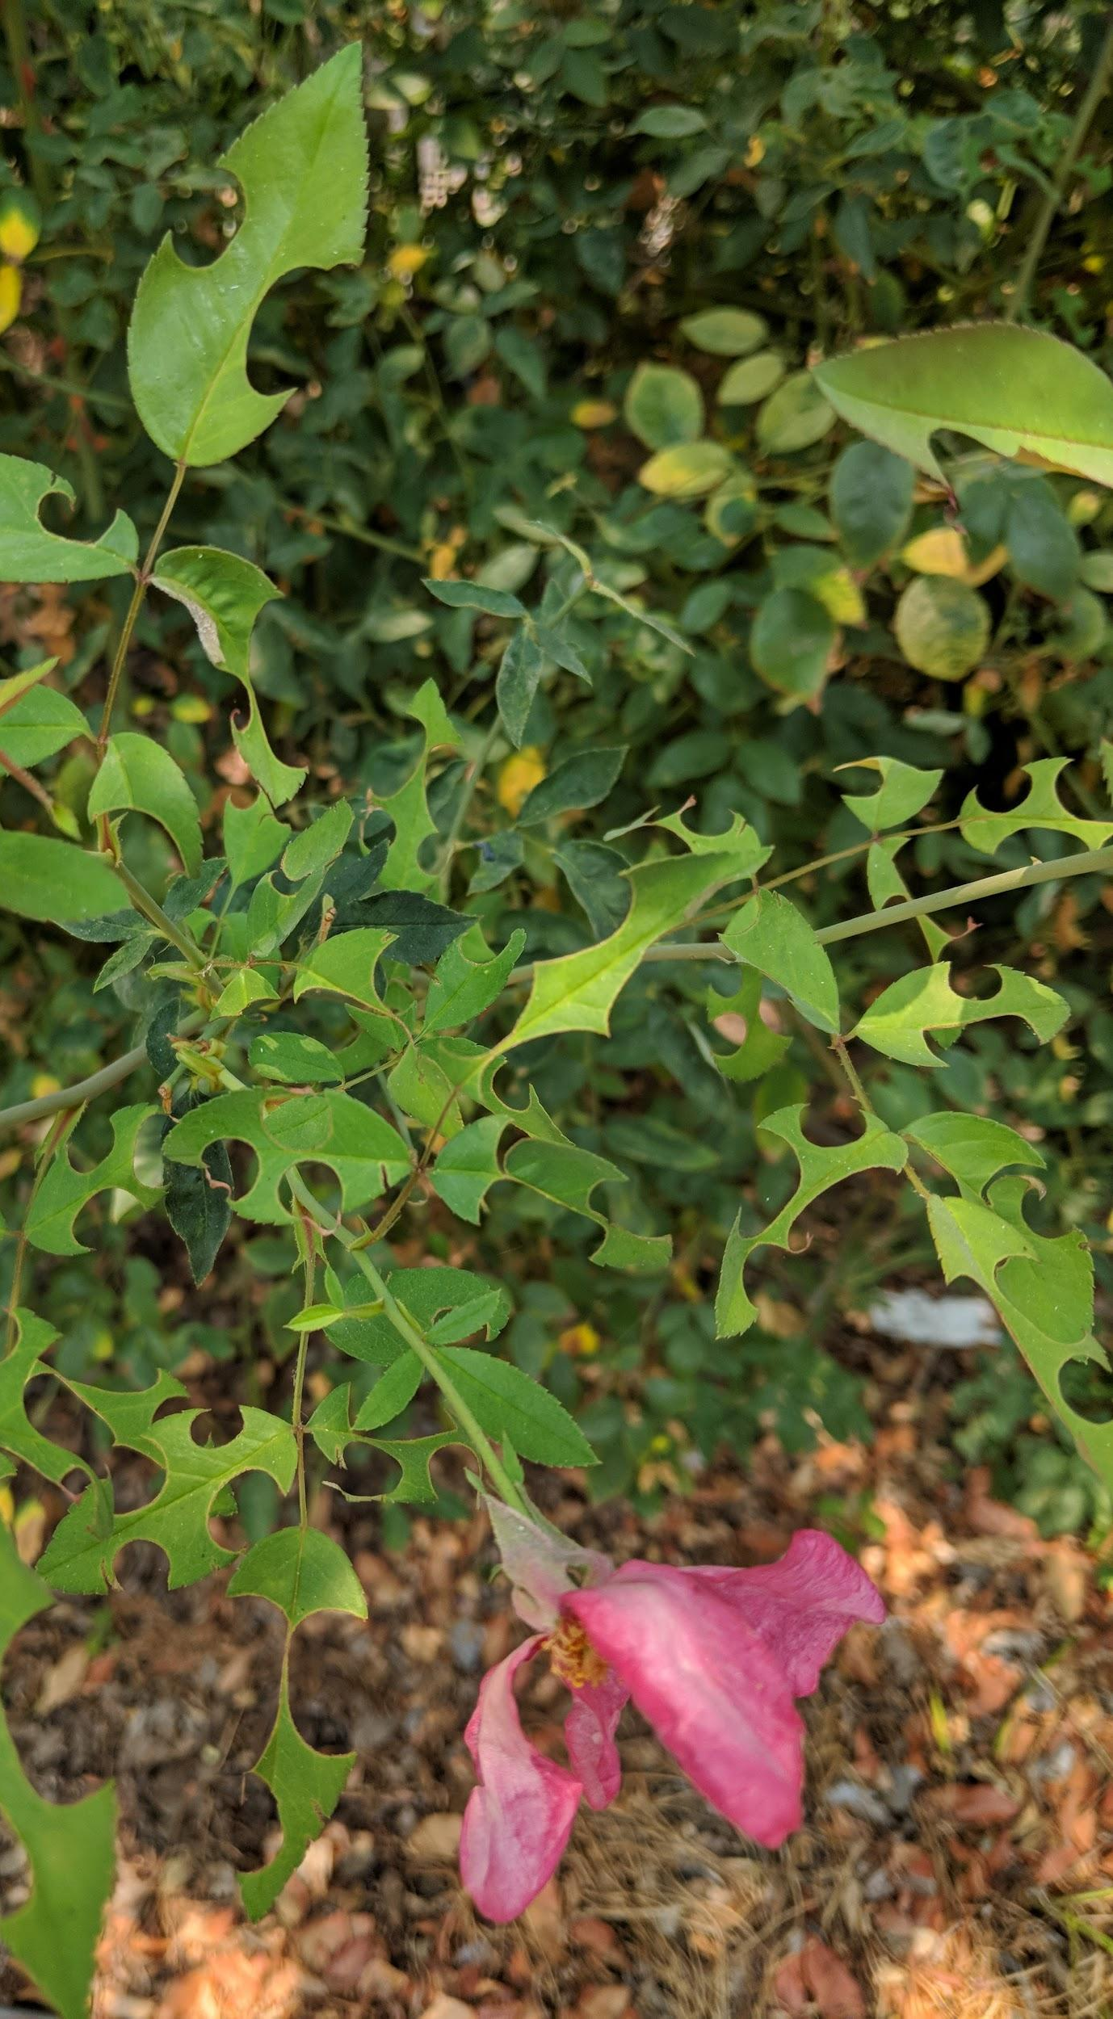
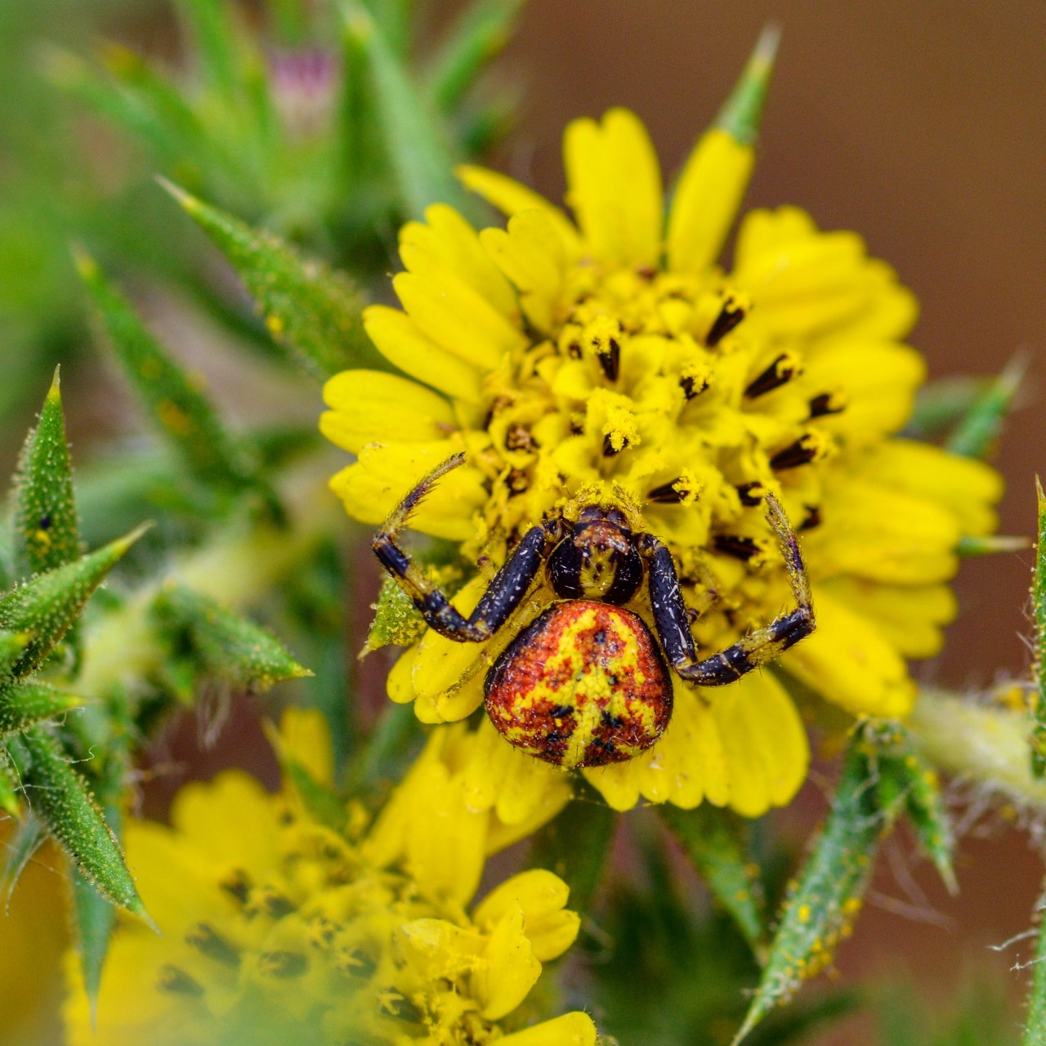
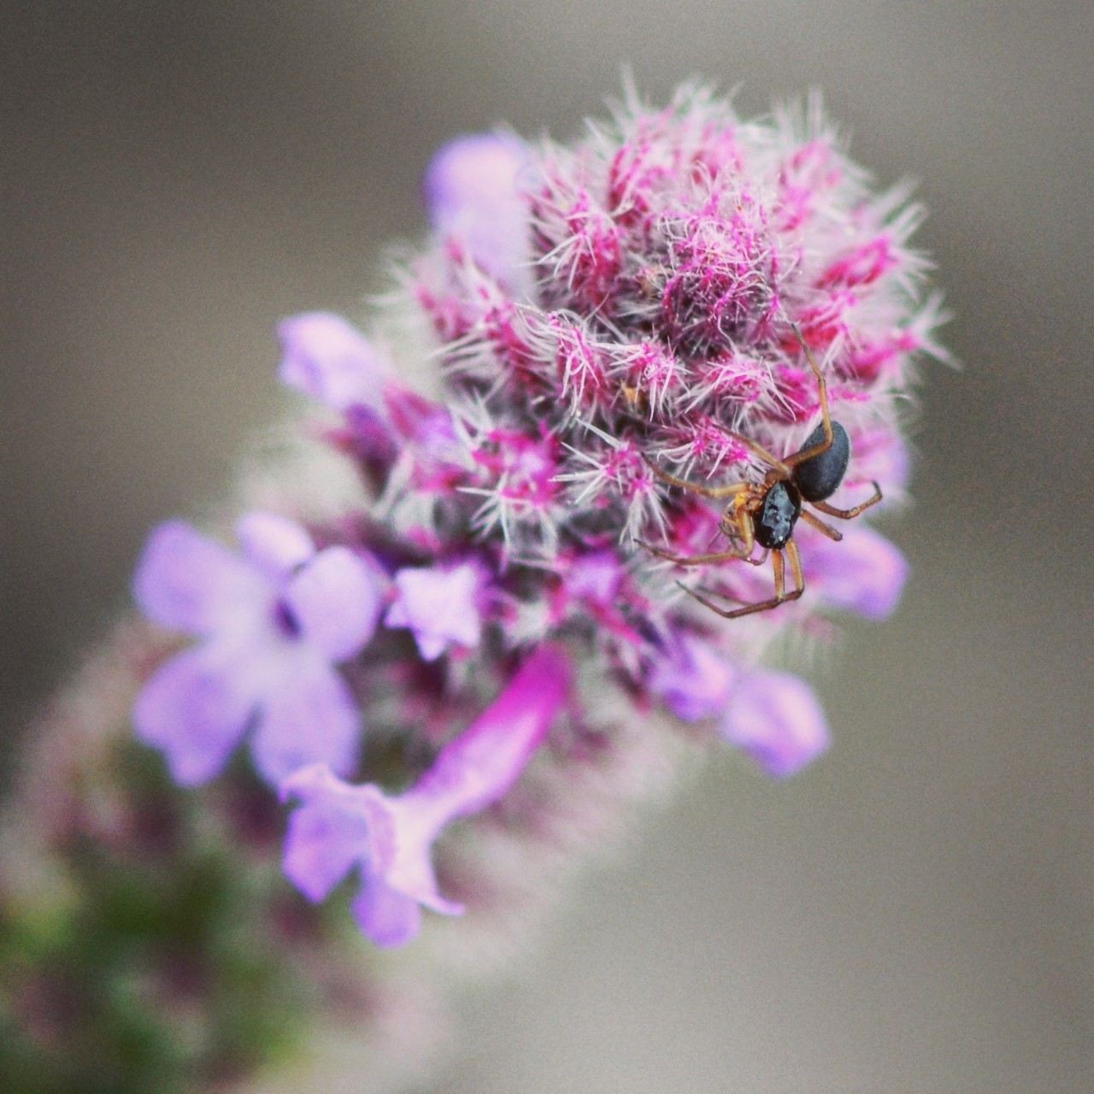
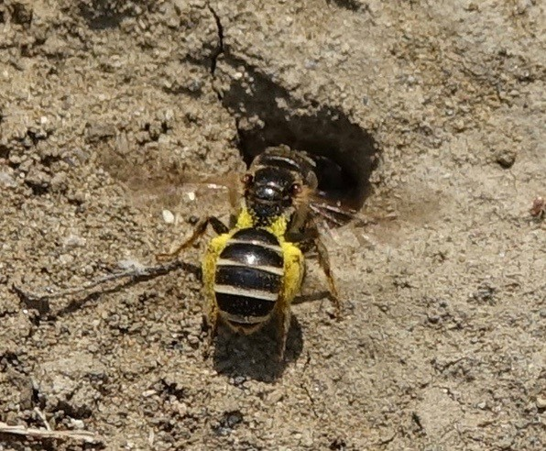
What to Observe
We are looking for everything that's happening in our environment so everything should be added as an observation
Especially look for species interactions! Like holes on leaves, scratches on bark, or a bee on a flower.
The ground is also a very important place for species activity
See if you can spot some roly-polies or lizards amongst leaf litter, or maybe even some bee nests in soft ground.
Remember to take photos of less charismatic critters like spiders and beetles!
These two contribute a lot to our ecosystem by controlling pests and eating decomposing materials.

Slide 11
Overall Pro-Tips
Remember to respect people's privacy and be aware of where you are. Not every living organism wants pictures of themselves or their physical home.
Choose one location to observe. Sit next to a flowering shrub, a rock garden, a patch of dirt, and look for movement. Odds are you’ll find something you never would have seen if you were moving
When trying to identify something, don’t forget iNaturalist can help you do that:
Search for the type of critter (ie butterflies) in your area and see what other people have seen.
Look up and follow experts in their field on iNaturalist to see what they have seen in the area, and grow your iNaturalist community!
Try taking pictures from multiple angles to let other naturalists figure out exactly what you saw!
Break up your observation time over a full day. Choose a location and spend 30 minutes observing in the morning, midday, and at dusk. You might see completely different things at each time in the same location!

Slide 12
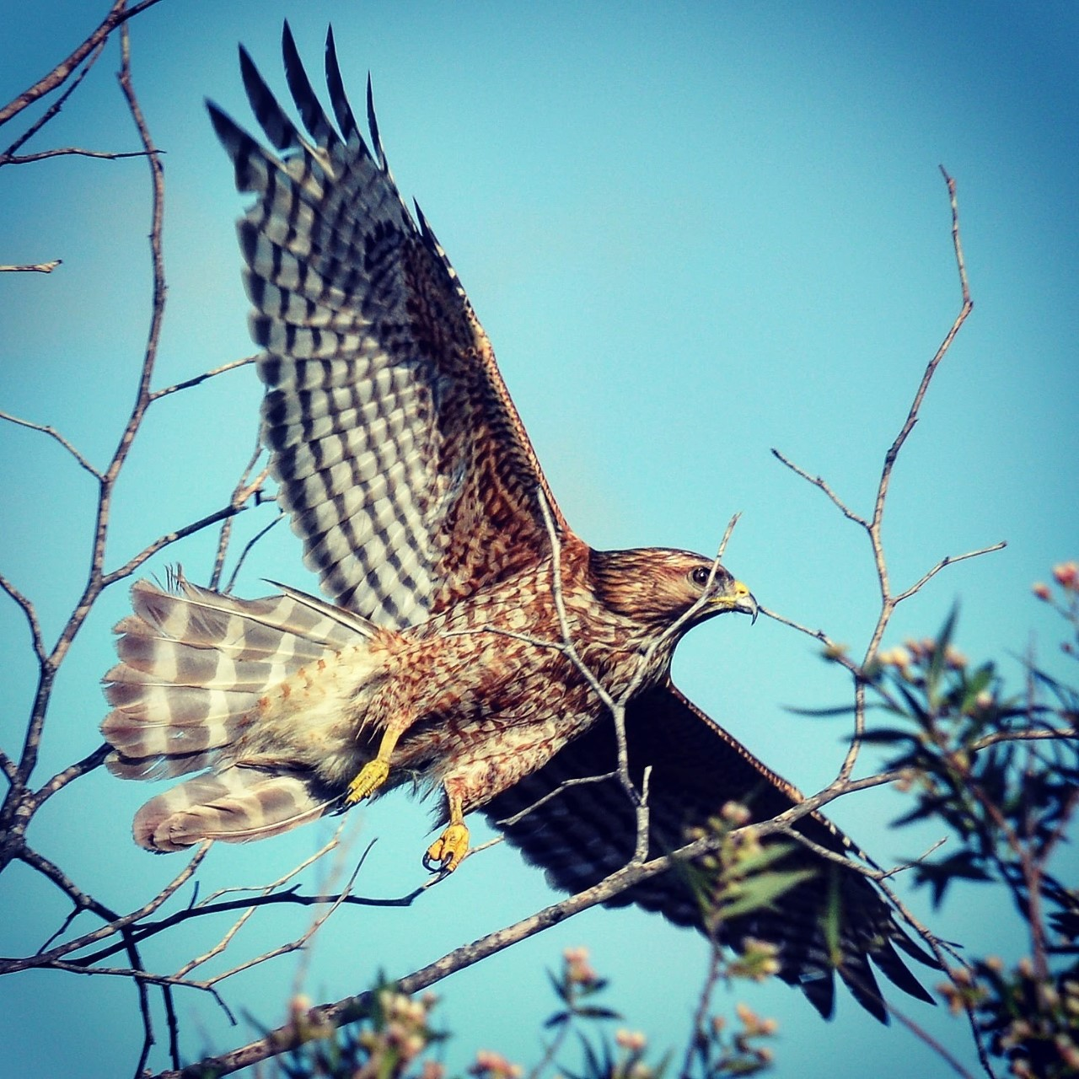
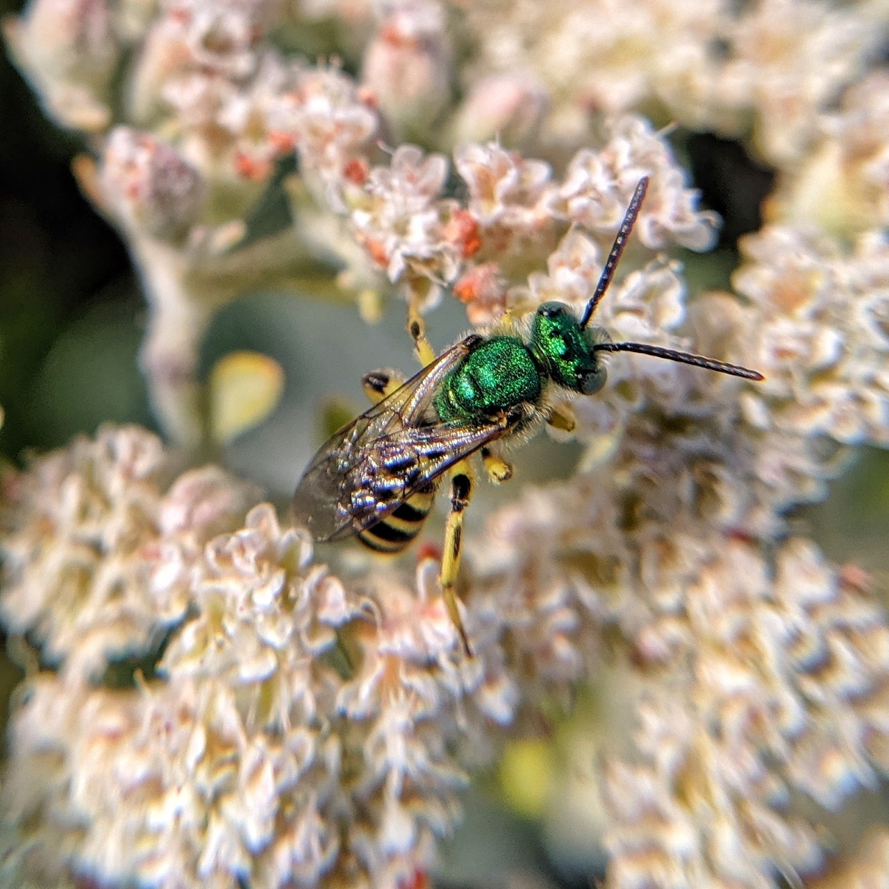
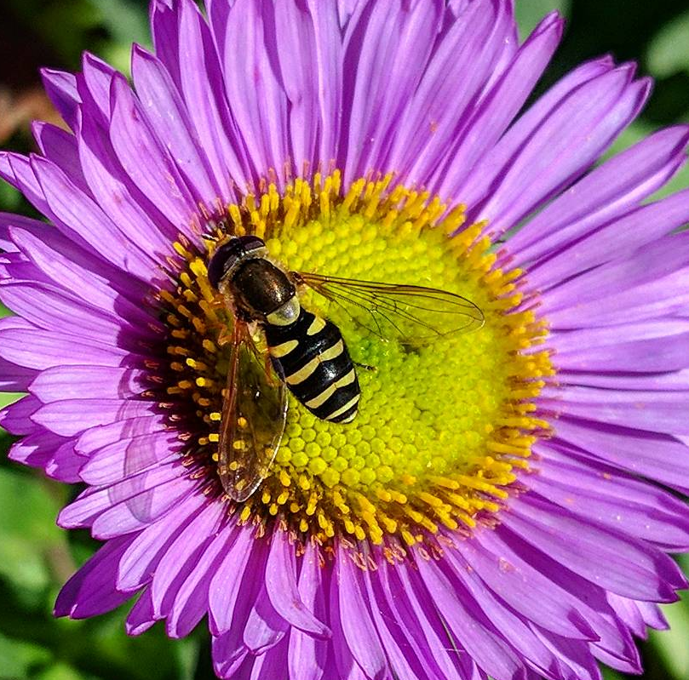
Animal Pro-tips
Bees and flies often mimic each other, so they can be difficult to tell apart. (Many critter make their living by imitating others!) Bees have long antennae and oval-shaped eyes, while flies have very short antennae and eyes that take up most of their face.
When looking for pollinators, notice different flight patterns. Common honeybees have a slow flight, while flies have erratic, hovering movements. California native bees often look like little gray blurs and also have fast, erratic flight.
Bird shots are best with a digital camera with a good zoom lens. Birds are often far away and clear photos are needed for the identification process.
VS.
Fly
Bee

Slide 13
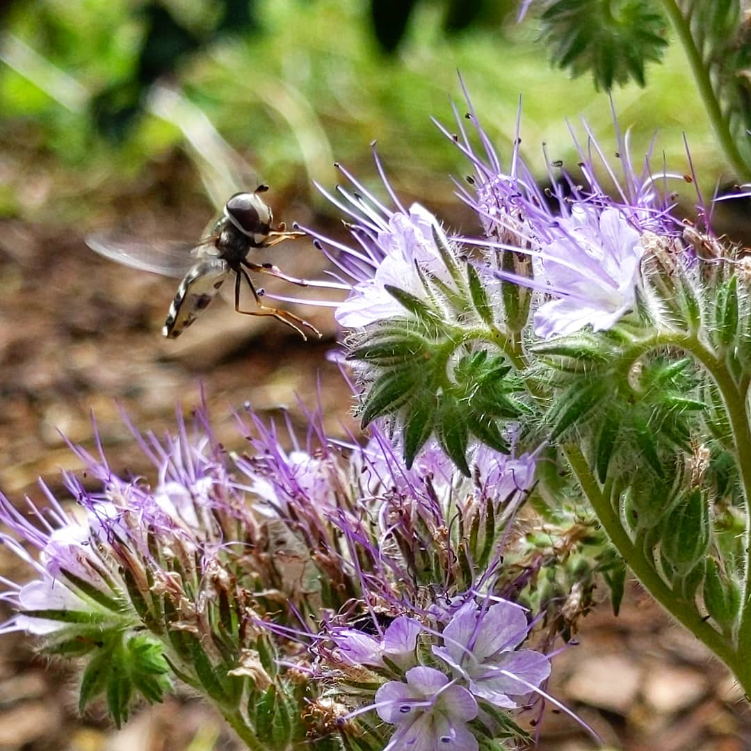
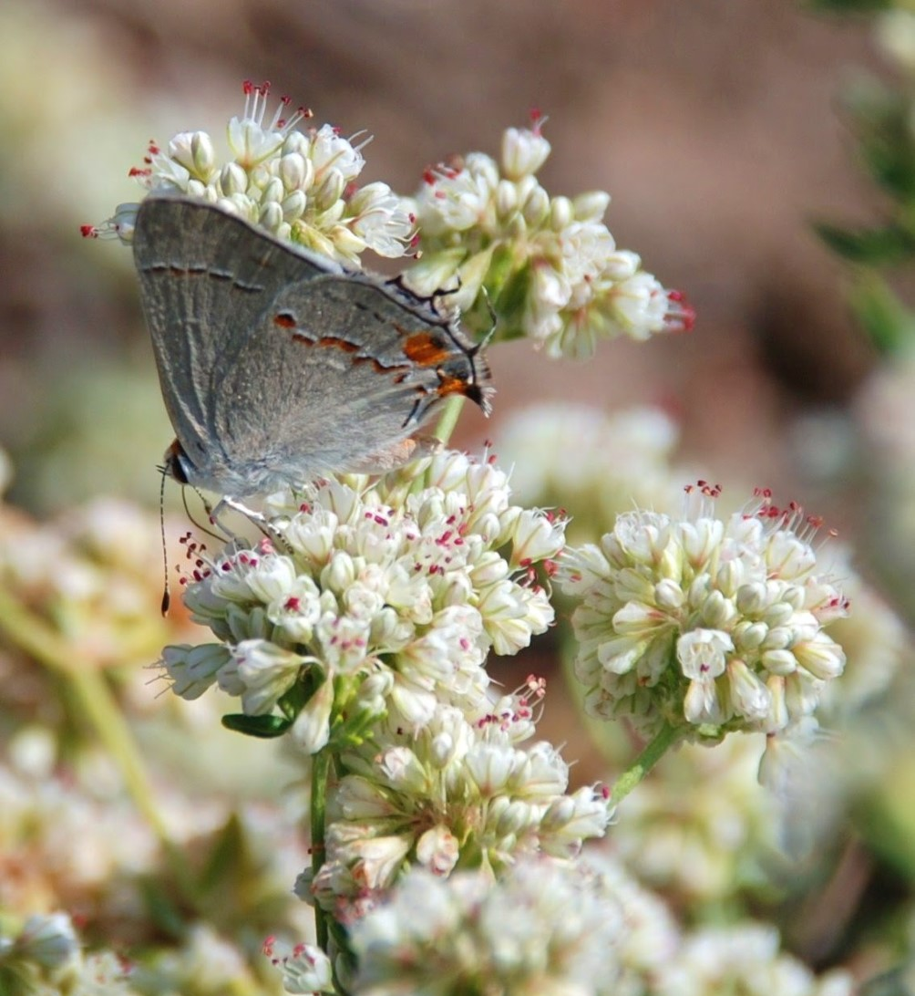
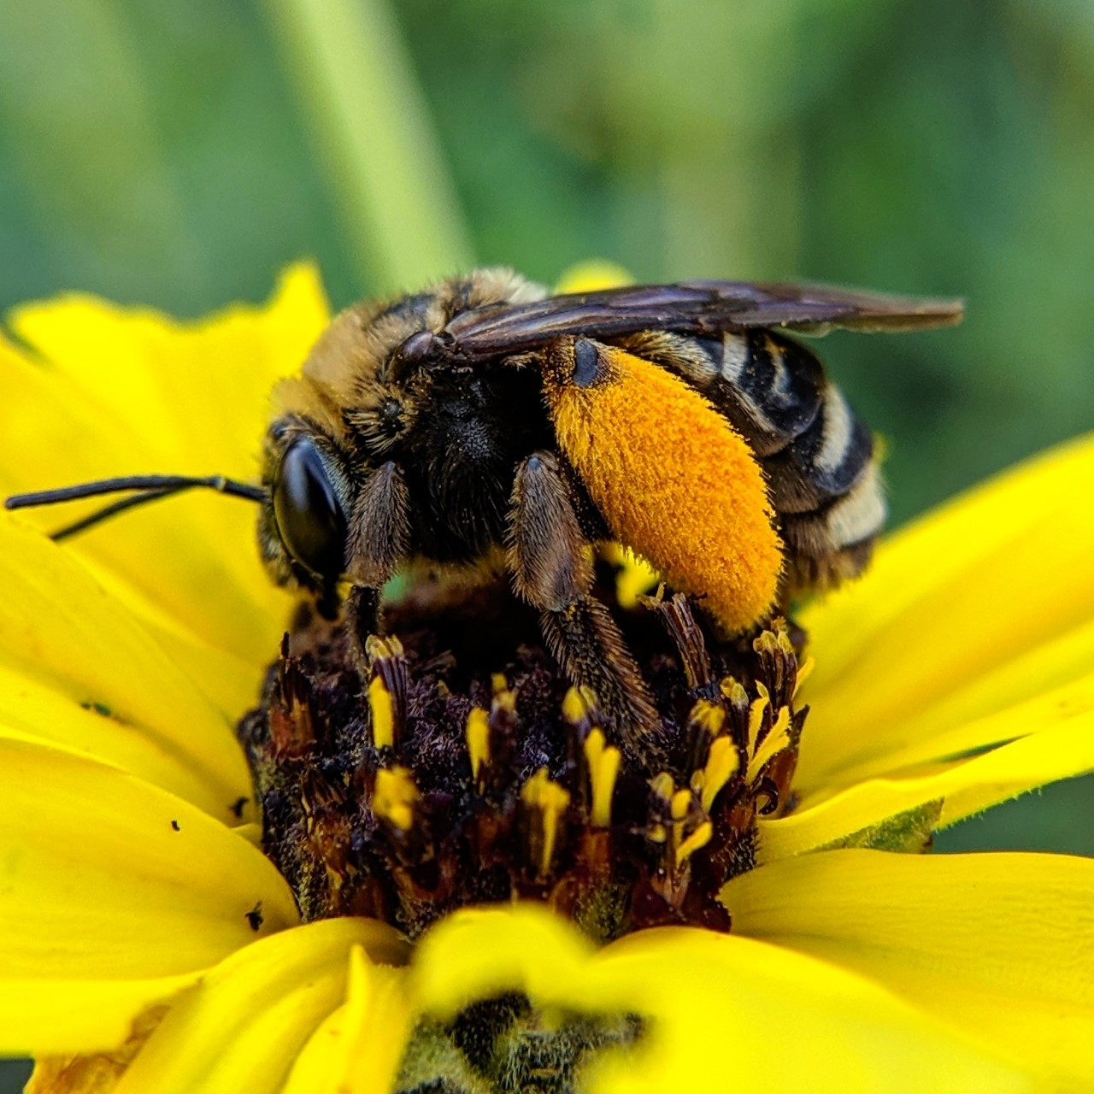
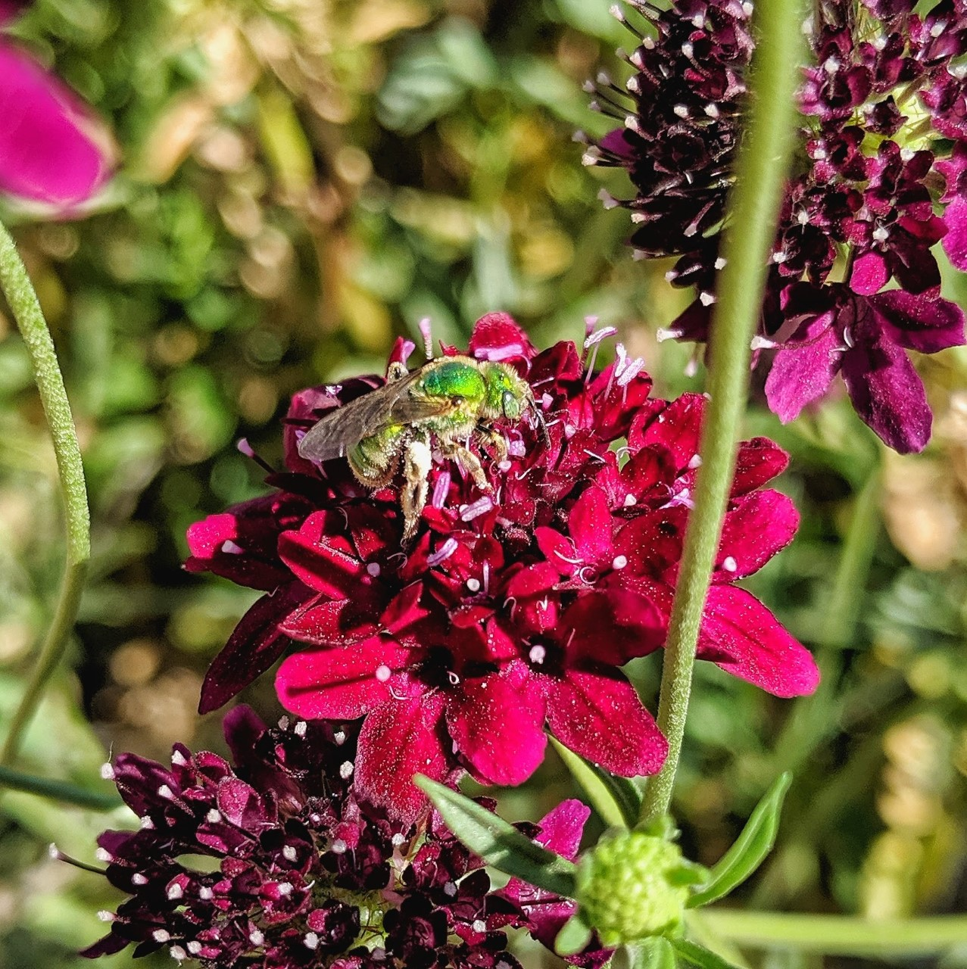
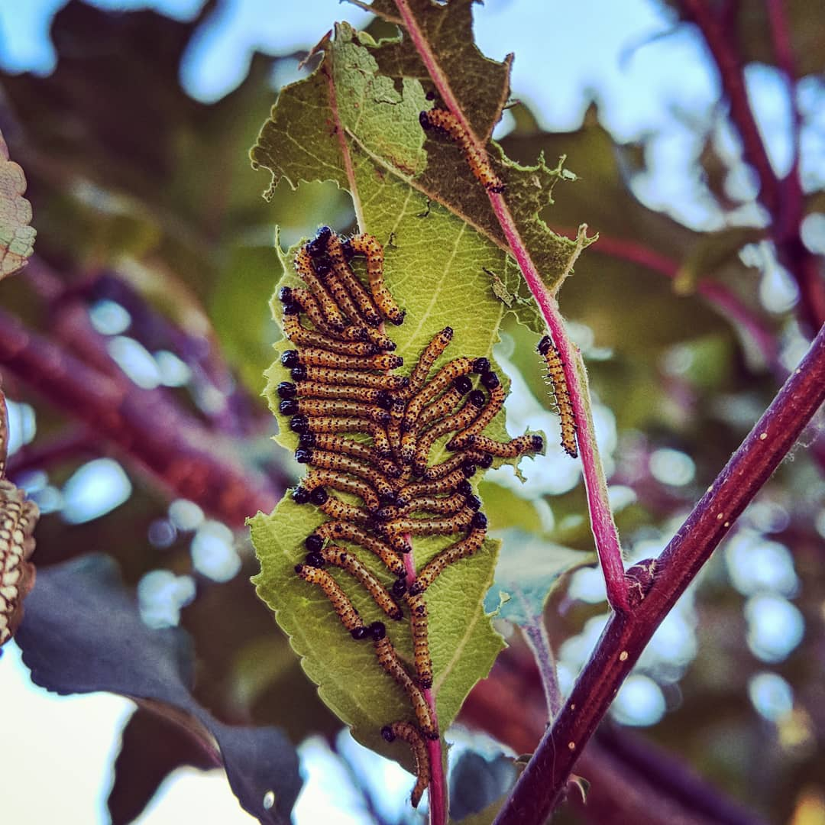
Enjoy spring as we get to know nature at home!

